Slide 1

California Football Officials Association
June 2024
2024-2026 Mechanics Changes

Slide 2
Table of Contents
Introduction and Acknowledgements
General Updates and Points of Emphasis
  Greg Truex, CFOA State IC
Referee Changes
  Shane Smith, Inland Empire
Umpire Changes
  Charlie Chastain, Inland Empire
Flank Changes
  Eddie Gaxiola, San Gabriel
Back Judge Changes
  Gil Rodriguez, Inland Empire

Slide 3
Introductions and Acknowledgements
During the 2024 offseason, the CFOA Board sought to review and make any necessary revisions to the CFOA Mechanics Manual for our officials
A cross-unit, cross-position committee was formed to collaborate and share best practices from each unit, but to also provide consistency across all units

Slide 4
Introductions and Acknowledgements
Please join me in thanking all of the officials below that took time during the offseason to review and provide feedback on their position
Referees: Umpires: Deeps:
Shane Smith, Chair Mark Haynes, Chair Gil Rodriguez, Chair
Mike Licata, Coachella Valley Charlie Chastain, Inland James Knapp, Coachella Valley
Tony Burquez, Channel Coast Rick Sherwood, Coachella Valley Tim Glasgow, Channel Coast
Don Mulligan, Redding Mark Youngdahl, Orange County Keeton Cahill, Redding
Brain Brennan, Orange County Dave Mushinskie, Foothill-Citrus Corey McManimen, Orange County
Alex Castro, San Gabriel Valley Kenny James, San Gabriel Valley Garrett Earls, Foothill-Citrus
Lance Rosencranz, Long Beach Joe Lloyd, Long Beach Jose Gaxiola, San Gabriel Valley
Mark Milsom, San Fernando Valley Wayne Windman, South Bay James Reeves, Long Beach
Steven Richard, South Bay Carl Husfeld, San Fernando Valley David Richard, South Bay
Flanks:
Eddie Gaxiola, Chair, San Gabriel; Jonathan Maskevich, Coachella Valley; Michael Walla, Cochella Valley; Jeremiah Bidwell, Redding; Greg Baarts, Redding; Tom Innocenti, Orange County; Rick Langemeier, Orange County; Juan Puentes, San Gabriel Valley; Brandon Ballou, Long Beach; Todd McWherter, Channel Coast; Ralph Walker, South Bay; Ron Maden, South Bay.

Slide 5
General Updates
The following have been added to the CFOA Mechanics Manual:
  CIF Overtime Procedures
  7-Person Mechanics
  CFOA Approved Officials Jersey
  New (Optional) Coin Toss Mechanic
  Whistle Mechanics detail
  Onside Kick Mechanic added
  Scrimmage kick formations – know who is in/eligible
  Scrimmage Kick “Coffin Corner” mechanic added
  Additional detail on foul reporting, penalty enforcement responsibilities
  Updates to CFOA Standards

Slide 6
Points of Emphasis
Judgement – Be 100% certain a foul occurred. If you “think you saw something, then you didn’t see it. A “no call” is more acceptable than an incorrect call.
Be a great dead ball official. There is always something to be done between downs.
Lateral position of the ball
Correctly reporting fouls to your Referee, including the result of the play
Count players every…single…down, don’t signal for the sake of signaling

Slide 7
Referee Changes
The following have been added to the CFOA Mechanics Manual:
  Flexibility for the R to work 15-17 yards from the LOS, 7-12 yards wide
  Referee now has the option to work on the wide-side, non-throwing arm side of the quarterback

Slide 8
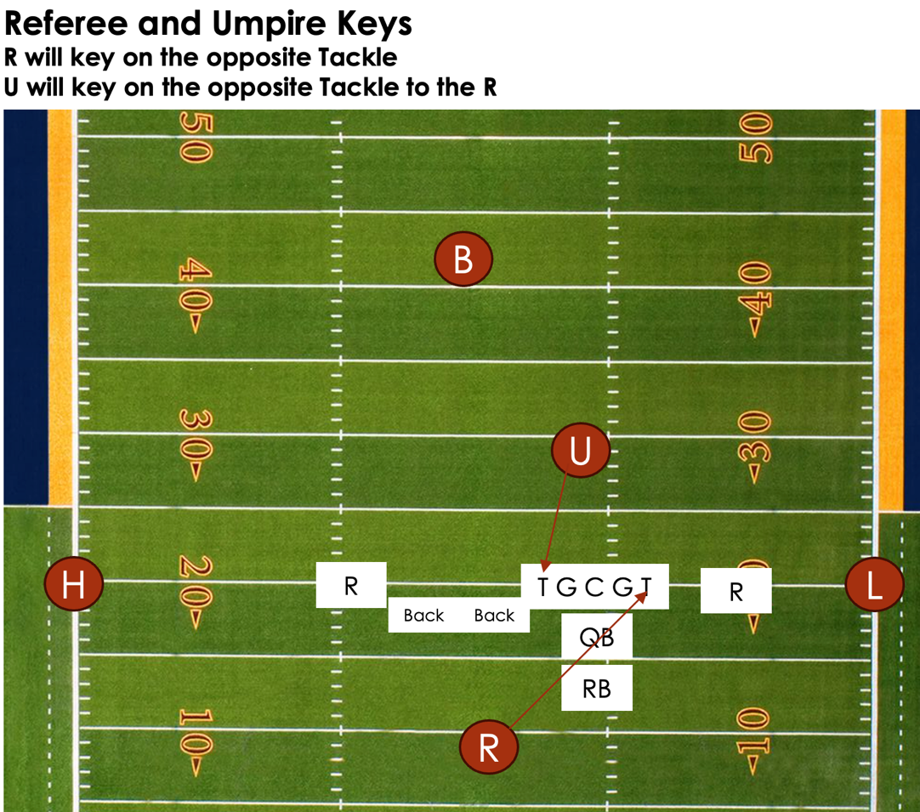
Referee – Wide-side of the field
Assuming a right-handed QB…
The Referee will always key on the opposite tackle to keep the QB in their field of view
The Umpire will always key on the Tackle opposite the Referee’s position

Slide 9
Back Judge Changes
The following have been added to the CFOA Mechanics Manual:
  BJ should carry 2 bean bags
  With 10-seconds remaining on the play clock, the BJ will raise their hand in the air. With 5-seconds remaining, the BJ will provide a visible upward motion, counting down the last 5-seconds
  Start in the middle of the End Zone when the ball is between the 19-yard line and the 12-yard line. Move to the goal line on run plays, move to the end line if threatened.

Slide 10
Flank Changes
The following have been added to the CFOA Mechanics Manual:
  H will walk off penalty enforcement with the U, LJ will hold the enforcement spot and confirm the enforcement is correct
  Limit movement based on down and distance
  H and L will always line up on the Team R restraining line for a free kick
  H and L will now stay on the LOS for any scoring scrimmage kicks at/inside the B-20

Slide 11
Umpire Changes
The following have been added to the CFOA Mechanics Manual:
  Umpire should wear 2 down indicators, one for the down and one for the lateral position of the ball
  Pre-Snap mechanics updated
  Short passes, especially in the middle of the field, the Umpire should now turn with the pass to help rule on the catch

Slide 12
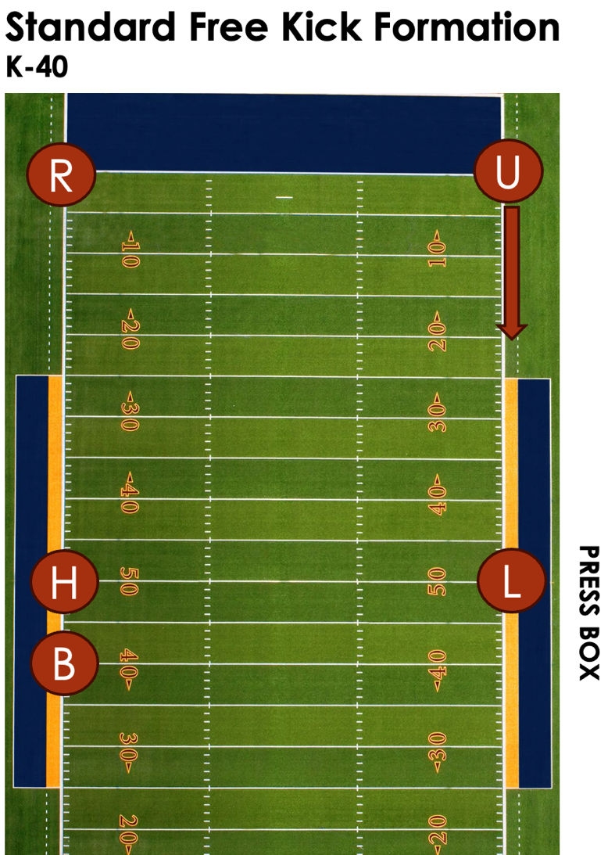
Free Kick Mechanic
The Umpire will now start on the goal line, opposite the Referee.
  U has the flexibility to move as far up to the R-20, without having to turn your back to action on the field.
The H and L will not start on the Team R restraining line.
The BJ will be on the Team K restraining line

Slide 13
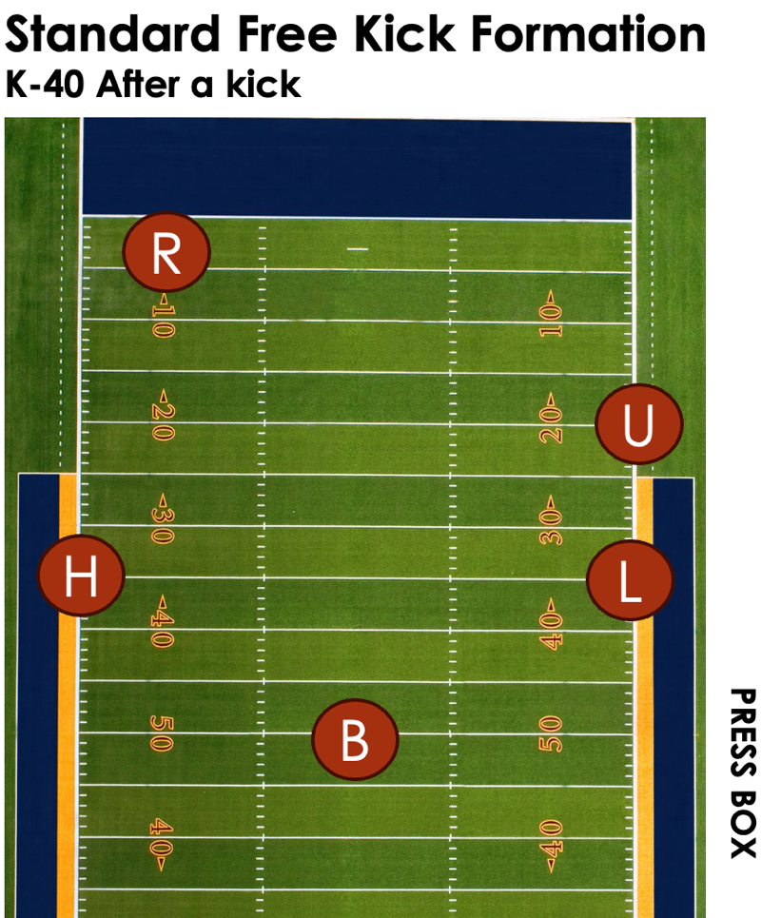
Free Kick Mechanic
The Umpire will move up field, no more than 10-yards from the L
The H and L will move 12-15 yards down field on a deep free kick
The BJ will take a position on the field after the kick.

Slide 14
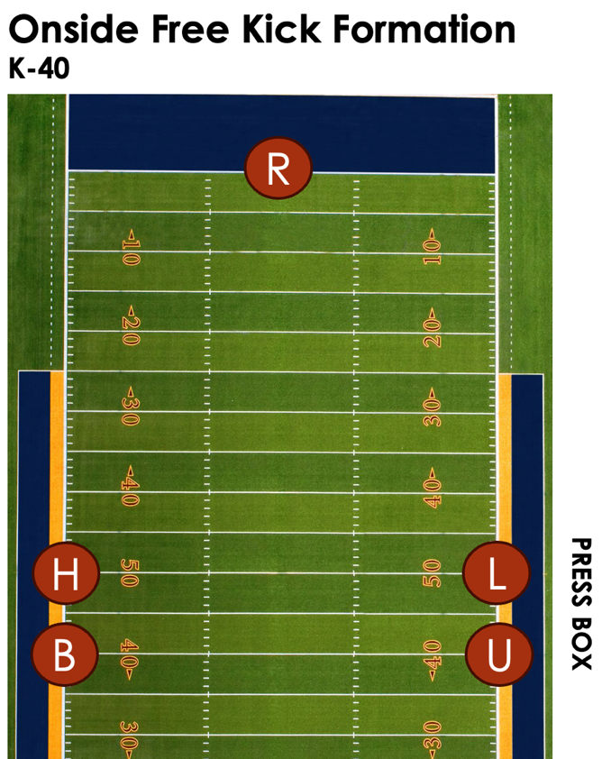
Onside Kick Mechanic
The Umpire will move up field and line up on the Team K restraining line
The H and L will stay in their positions on the Team R restraining line

Slide 15
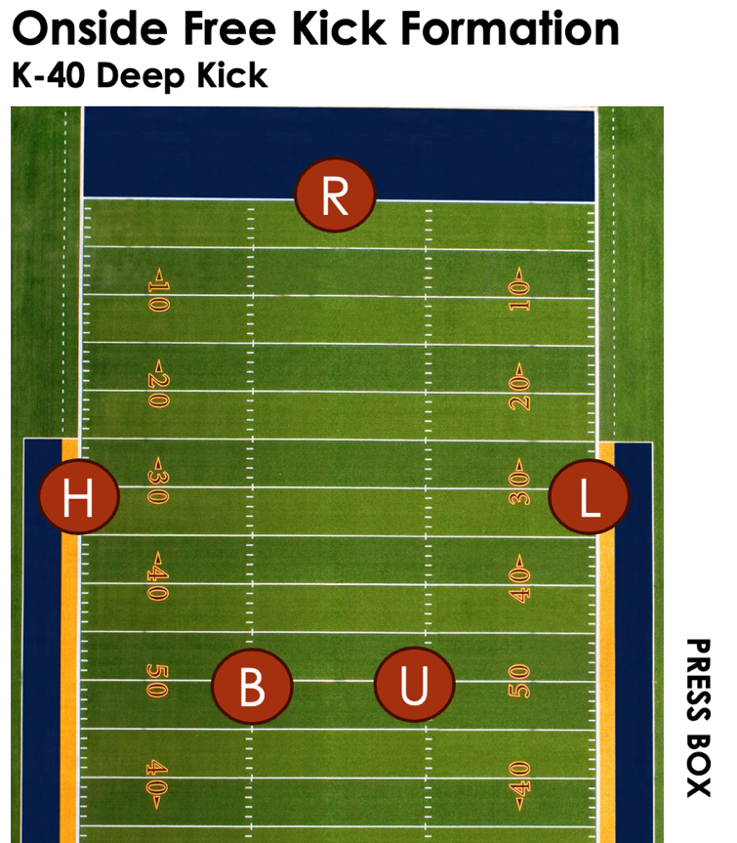
Onside Kick Mechanic
If the ball is kicked deep when we are in an onside kick formation, the B and the U will take a position on the field after the kick.
The H and L will always have Team K goal line responsibility.

Slide 16
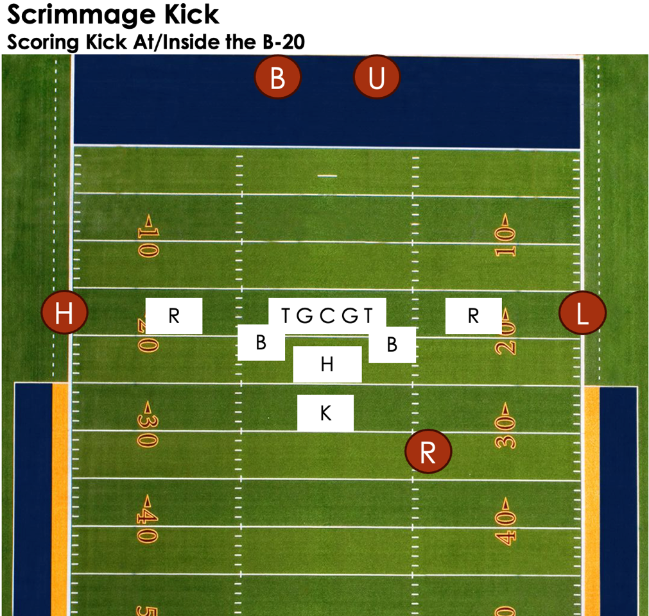
Scoring Scrimmage Kick Mechanic
When a scrimmage kick is attempted at/inside the B-20, or during a kicking Try, the Umpire will now line up under the goal post with the BJ.
Umpire will still have responsibility for the snapper. After spotting the ball, remind Team R to “lay off the snapper until he can protect himself”.

Slide 17
Thank you for attending tonight…
Please join me in thanking Shane, Charlie, Eddie and Gil for presenting tonight.
Quiz link
CFOA YouTube Page
Thank you again for coming out throughout the offseason. Good luck this season, have fun and only call what you see

